Slide 1
New Supplemental Benefits Offered

Slide 2
Raise Your Hand If…
You know someone who has:
Broken a bone
Suffered a Heart Attack or Stroke
Battled with Cancer

Slide 3
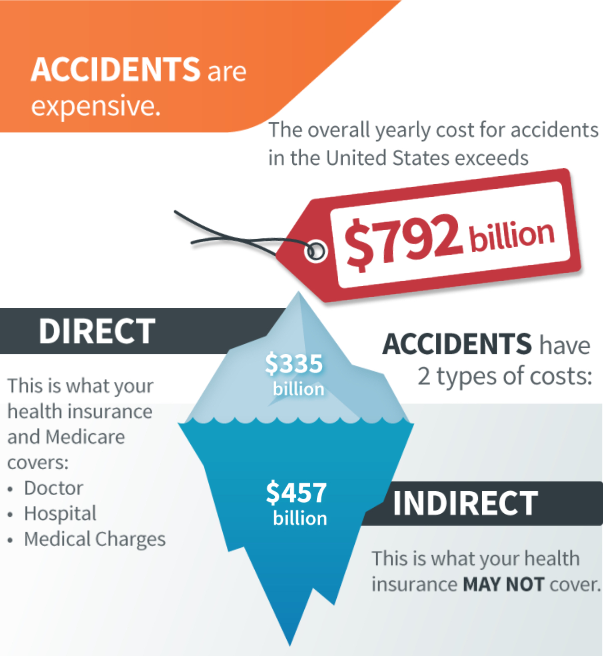
It’s the costs you don’t see that sink the ship

Slide 4
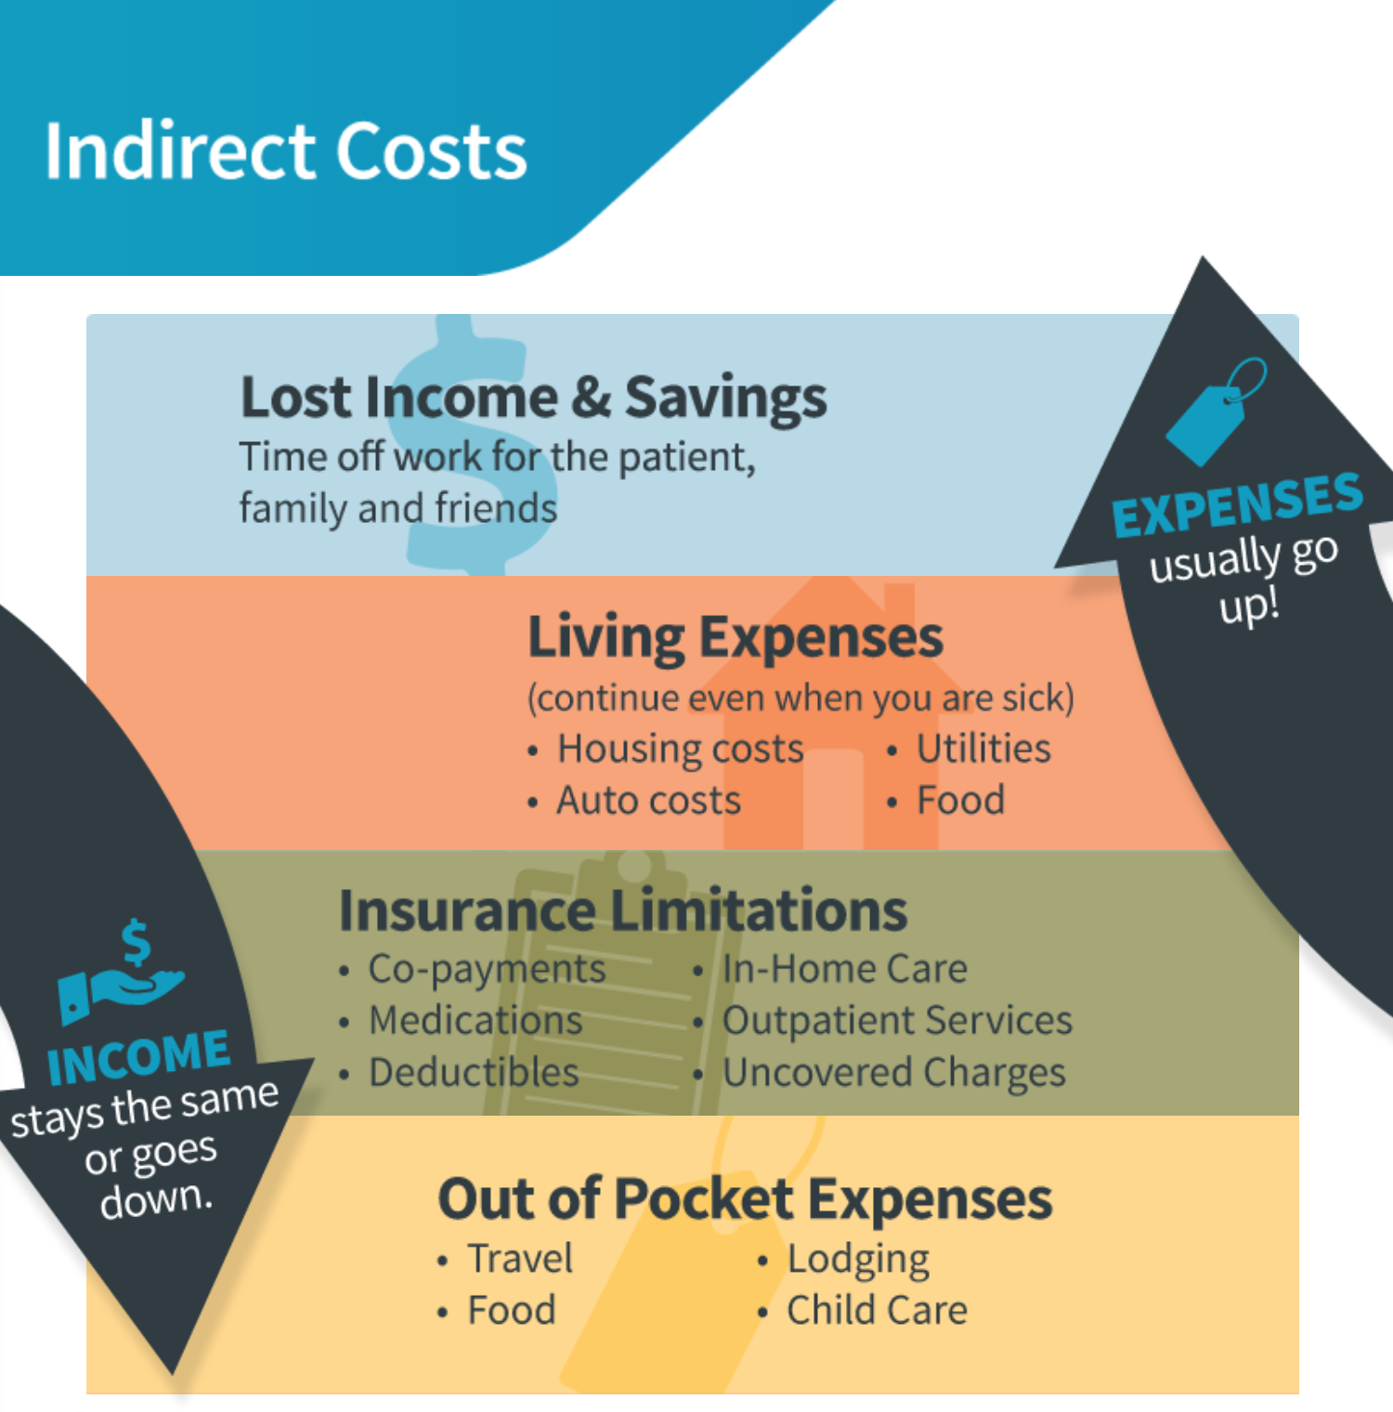

Slide 6
Examples of Benefits
ICU for ANY reason $2,000 a day up to 30 days ($60,000)
If you are in ICU from a vehicle accident the benefit doubles $4,000 a day ($120,000)
Ambulance Ride $1,200

Slide 7
THIS MONEY IS DIRCECT DEPOSITED TO YOU

Slide 8
Reasons People Enroll
Affordable: plans range from $1-5/day depending on age and level of coverage
No Lifetime Limits
Premiums never change WE HAVE NEVER RAISED A RATE ON AN EXISITING POLICY HOLDER
Guaranteed Renewable: You can never be cancelled
Phone call is answered by a live person in the US

Slide 9
Get Your Money Back

Slide 10
Please fill out surveys and return them to me when you are done, Thanks!

